Slide 1

Industria 4.0, internazionalizzazione delle imprese e implicazioni per lo sviluppo di nuove competenze
Mario Volpe, Università Ca’ Foscari Venezia

Slide 2
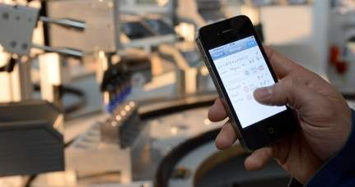
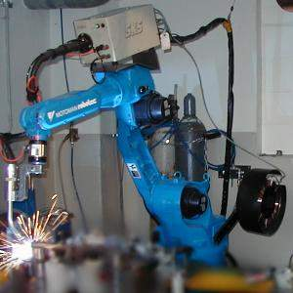
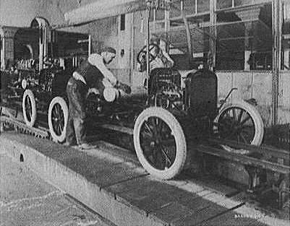
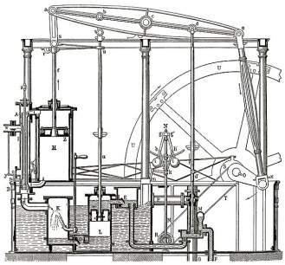
Le “rivoluzioni” industriali
4. Industrial revolution
Based on cyber-physical-
systems
3. Industrial revolution
Through the use of electronics
and IT further progression in
autonomous production
2. Industrial revolution
Introducing mass production
lines powered by electric
energy
Level of complexity
1. Industrial revolution
Introducing mechanical
production machines powered
by water and steam
Industry 1.0
Industry 2.0
Industry 3.0
Industry 4.0
End of the
18th century.
Beginning of the
20th century
Beginning of the
70th
Today
Source: DFKI/Bauer IAO

Slide 3
Componenti tecnologiche di Industry 4.0
Industry 4.0
Autonomous Robots
Simulation
Horizontal and vertical system integration
Additive Mfg
Industrial Internet of Things
Augmented reality
Big data analytics
Cyber Security

Slide 4
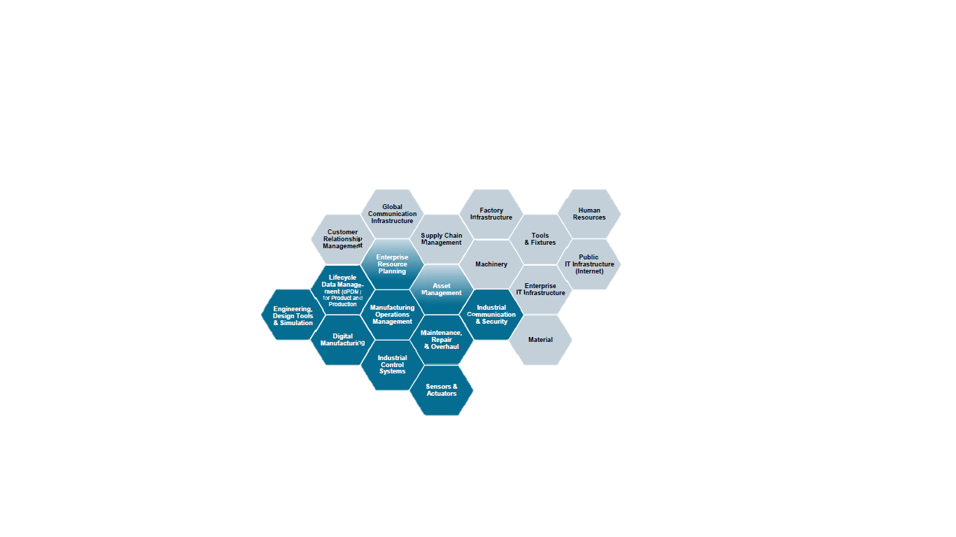
I 4.0 coinvolge tutti gli elementi della catena del valore

Slide 5
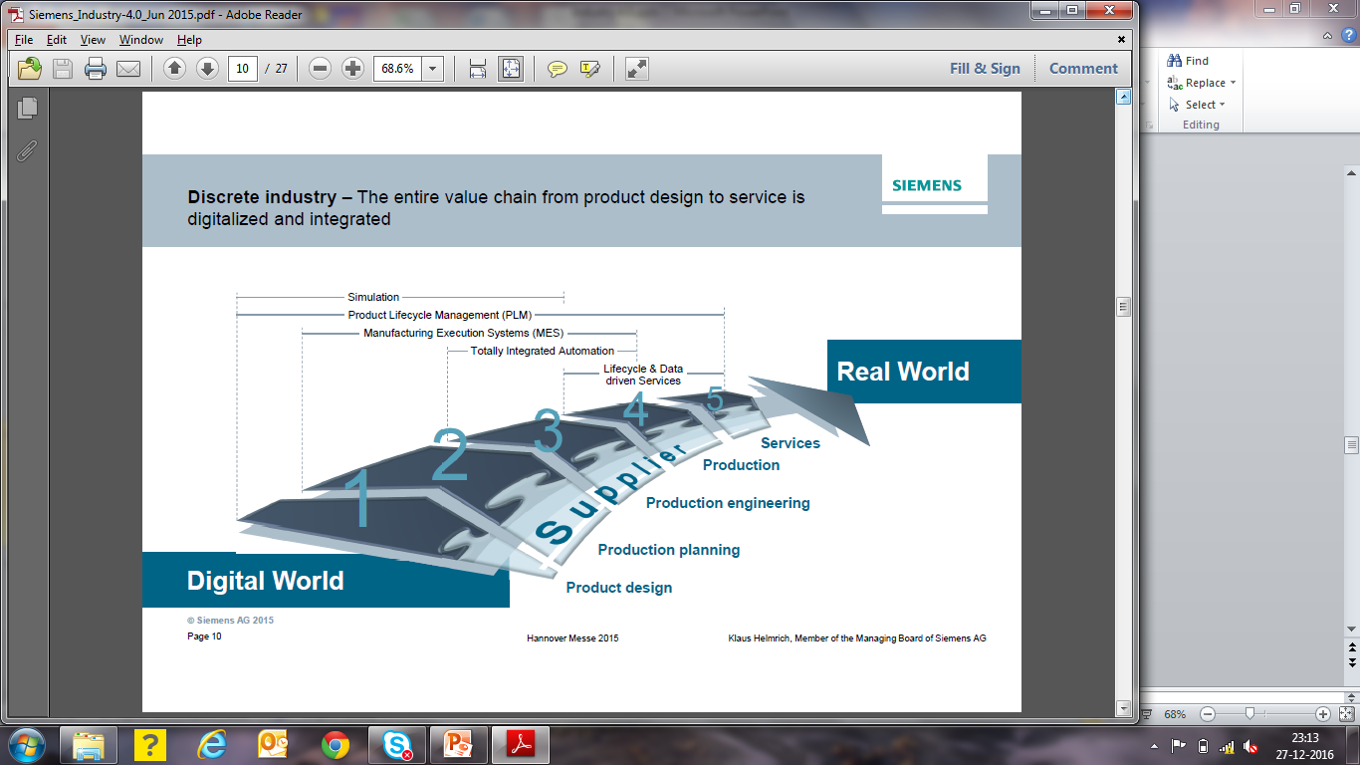
Impresa digitale

Slide 6
Implicazioni
Robot Assisted production
Additive manufacturing of complex parts
Machines as a service
Big data drive quality control
Production line simulation
Predictive Maintenance
Smart supply network

Slide 7
Internazionalizzazione e Globalizzazione
Teorie sul commercio e la crescita
(Washington Consensus ?)
  Vantaggi comparati
  Product cycle
  Export growth
  Learning by doing
  Technology catch-up

Slide 8
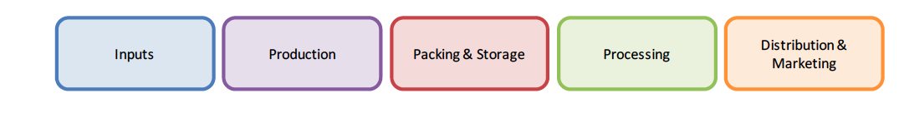
Global Value Chain

Slide 9
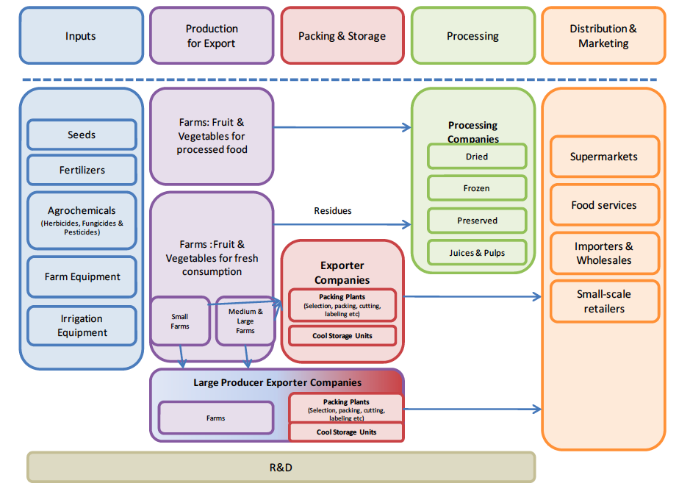
Fruit and Vegetables Global Value Chain

Slide 10
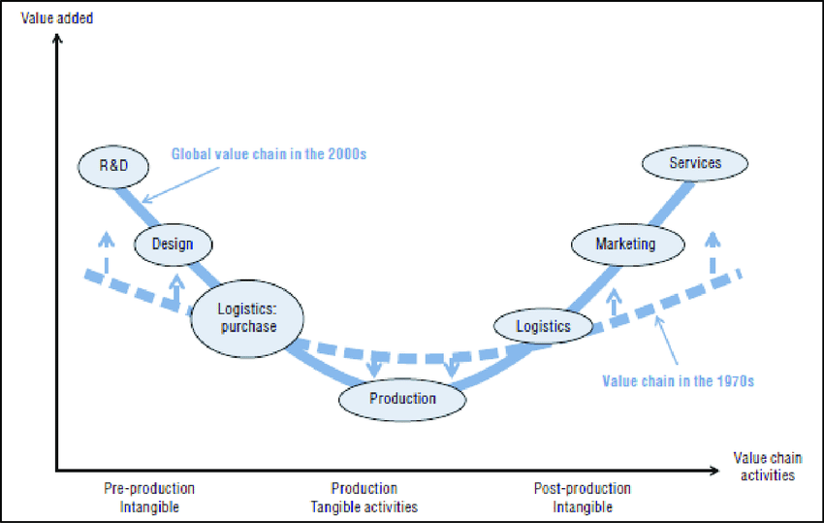
Smile Curve

Slide 11
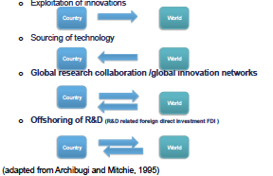
Background

Slide 12


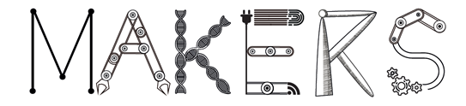
Una ricerca di Ca’ Foscari
Knowledge and diffusion of digital technologies
Enabling factors
  Human capital
  Internationalization
  Financial structure
Impact on firms’ performance
  Productivity
  Profitability
  Distribution among stakeholders
Robotics/automation
Industrial Internet of Things
Smart products
3D printing
Mixed reality
Big data
Virtualization of IT systems
MAKERS - Smart Manufacturing for EU growth and prosperity is a project funded by the Horizon 2020-MSCA- RISE - Grant agreement number 691192.
Notes:
Cyber-physical systems
Increased velocity through the Research-Development-Innovation pipeline

Slide 13
Piano della ricerca
2016 | Quest | Resp
Manufacturing | 8.010 | 633
Construction | 507 | 51
Tertiary | 2.810 | 207
2017 | Quest | Resp
Manufacturing | 1.074 | 1.033
Data source: Unioncamere Veneto
Stat. Model: Panel 2007-2016
Data source: CCIAA TV-BL
Stat. Model: Logit
Links with micro-data:
Human Capital – SILV
Export/Import – Istat-Unioncamere
Financial structure – AIDA
MAKERS - Smart Manufacturing for EU growth and prosperity is a project funded by the Horizon 2020-MSCA- RISE - Grant agreement number 691192.
Notes:
Cyber-physical systems
Increased velocity through the Research-Development-Innovation pipeline

Slide 14
Conoscenza e adozione di tecnologie I 4.0
MAKERS - Smart Manufacturing for EU growth and prosperity is a project funded by the Horizon 2020-MSCA- RISE - Grant agreement number 691192.
Notes:
Cyber-physical systems
Increased velocity through the Research-Development-Innovation pipeline

Slide 15
Fattori abilitanti
Human capital
 | Manufacturing |  | Construction |  | Tertiary |  | Total
 | Digital users | Digital non-users | Digital users | Digital non-users | Digital users | Digital non-users | Digital users | Digital non-users
No skilled | 12,31% | 10,91% | 10,64% | 16,65% | 0,49% | 3,88% | 10,90% | 10,80%
High skilled | 24,85% | 21,35% | 31,91% | 14,01% | 62,26% | 30,56% | 29,42% | 21,51%
Medium skilled | 16,65% | 16,93% | 21,28% | 13,53% | 34,71% | 54,96% | 18,93% | 19,44%
Low skilled | 46,18% | 50,81% | 36,17% | 55,81% | 2,55% | 10,60% | 40,75% | 48,25%
High school | 45,02% | 42,61% | 45,47% | 30,78% | 56,92% | 49,69% | 46,43% | 42,33%
Degree | 14,70% | 8,05% | 15,41% | 4,17% | 38,06% | 34,57% | 17,47% | 9,77%
No education | 1,87% | 2,79% | 2,98% | 5,24% | 0,45% | 1,61% | 1,77% | 2,87%
Compulsory | 38,41% | 46,54% | 36,14% | 59,81% | 4,57% | 14,13% | 34,33% | 45,03%
MAKERS - Smart Manufacturing for EU growth and prosperity is a project funded by the Horizon 2020-MSCA- RISE - Grant agreement number 691192.
Notes:
Cyber-physical systems
Increased velocity through the Research-Development-Innovation pipeline

Slide 16
Fattori abilitanti: capitale umano
Dei 1149 posti di lavoro creati tra il 2012-2014, 870 (75%) sono collegabili alle imprese che utilizzano tecnologie digitali
MAKERS - Smart Manufacturing for EU growth and prosperity is a project funded by the Horizon 2020-MSCA- RISE - Grant agreement number 691192.

Slide 17
Fattori abilitanti
Internationalization
 | Export |  | Import
 | Digital users | Digital non-users | Digital users | Digial non-users
Construction | 30,35% | 8,66% | 48,51% | 10,59%
Manufacturing | 73,69% | 58,27% | 57,95% | 47,39%
Tertiary | 8,98% | 3,70% | 5,83% | 8,30%
MAKERS - Smart Manufacturing for EU growth and prosperity is a project funded by the Horizon 2020-MSCA- RISE - Grant agreement number 691192.
Notes:
Cyber-physical systems
Increased velocity through the Research-Development-Innovation pipeline

Slide 18
Fattori abilitanti
Performance & financial structure
 | Manufacturing |  | Construction |  | Tertiary
 | Digital users | Digital non-users | Digital users | Digital non-users | Digital users | Digital non-users
ROS | 6,17% | 4,78% | 5,67% | 1,90% | 5,75% | 1,79%
ROE | 13,65% | 14,73% | 19,61% | 8,12% | 23,71% | 6,92%
ROI | 15,47% | 15,70% | 6,36% | 1,35% | 32,04% | 3,86%
Value added per employee (va) | 65,27 | 56,45 | 73,89 | 49,98 | 60,62 | 65,08
leverage (L) | 1,28% | 1,52% | 2,34% | 1,29% | 1,17% | 2,07%
Net financial position (nfp) | 4.413 | 669 | 11.467 | 1.919 | 121 | 973
debt/equity | 1,03 | 0,82 | 0,70 | 1,80 | 0,47 | 1,37
MAKERS - Smart Manufacturing for EU growth and prosperity is a project funded by the Horizon 2020-MSCA- RISE - Grant agreement number 691192.
Notes:
Cyber-physical systems
Increased velocity through the Research-Development-Innovation pipeline

Slide 19
Fattori abilitanti
Digital users hanno maggiore produttività
…… usano più capitale proprio
…… redistribuiscono VA a favore del lavoro
……. Ottengono maggiori rendimenti finanziari solo nel medio periodo
MAKERS - Smart Manufacturing for EU growth and prosperity is a project funded by the Horizon 2020-MSCA- RISE - Grant agreement number 691192.
Notes:
Cyber-physical systems
Increased velocity through the Research-Development-Innovation pipeline

Slide 20
Fattori abilitanti
Joint effect
MAKERS - Smart Manufacturing for EU growth and prosperity is a project funded by the Horizon 2020-MSCA- RISE - Grant agreement number 691192.
Notes:
Cyber-physical systems
Increased velocity through the Research-Development-Innovation pipeline

Slide 21
Implicazioni
Digital technologies as growth factor
  Productivity
  Openness and Profitability in medium-long run
  Skills and Employment: human capital matters
Digital technologies affect location choices
  Shrinking in off-shoring pressure
  Positive impacts on re-shoring processes
Proper ecosystems need to boost the development and diffusion of new digital technologies
  Supply chain
  Local Innovation System
  Global production and innovation networks
MAKERS - Smart Manufacturing for EU growth and prosperity is a project funded by the Horizon 2020-MSCA- RISE - Grant agreement number 691192.
Notes:
Cyber-physical systems
Increased velocity through the Research-Development-Innovation pipeline

Slide 22
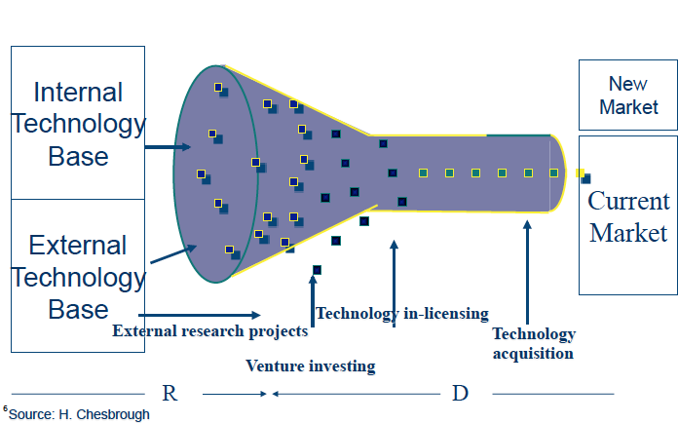
Open Innovation

Slide 23
Robots working in Amazon WH

Slide 24
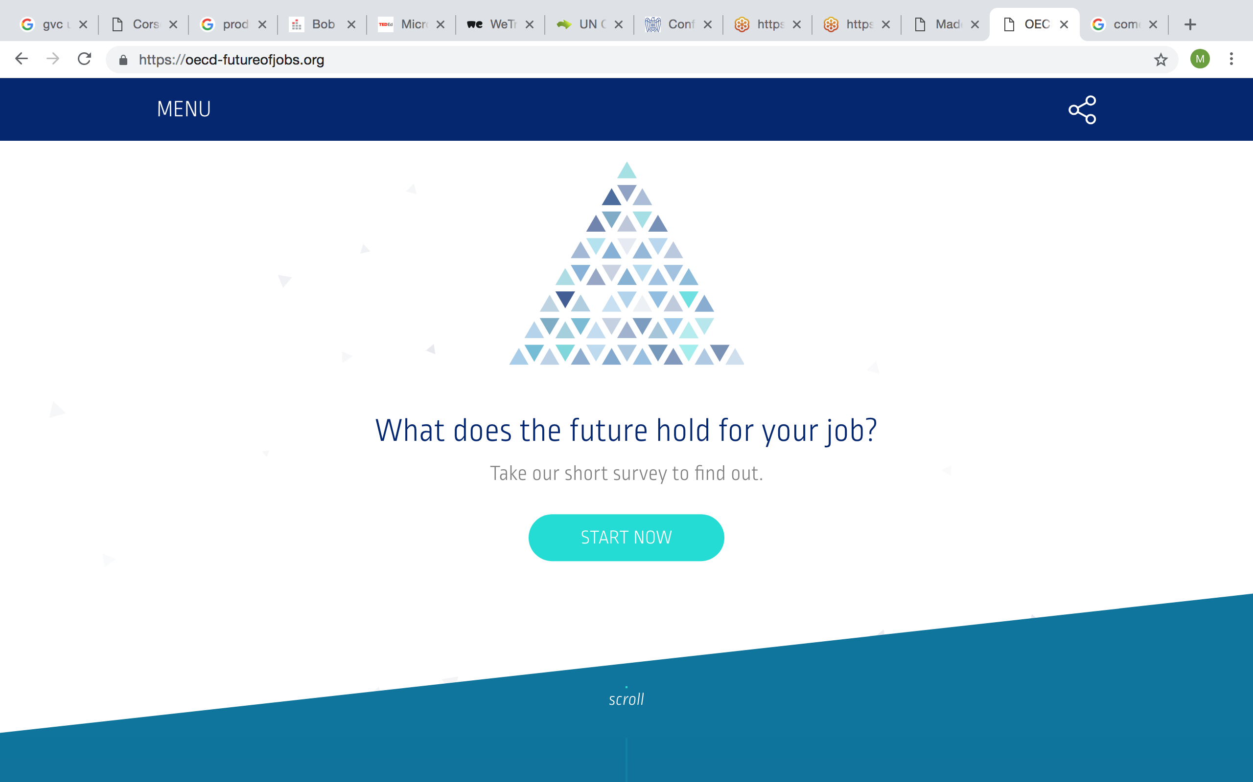
E i lavori di domani?

